Slide 1

Python for computational problem solving (ue23cs151a) mini project semester-1 ‘cracking CAPTCHA’
Team details:
Ankita Anand (PES1UG23CS080)
Anika P (PES1UG23CS073)
Aditi Prakash (PES1UG23AM021)
Ankita Muni (PES1UG23CS081)
Under the guidance of
Prof. Sindhu R Pai
Dept. of CSE
PES University

Slide 2
CAPTCHA
CAPTCHA or Completely Automated Public Turing Test to tell Computers and Humans Apart is a type of challenge- response test used in computing to determine whether or not the user is human. There are many kinds of prominent CAPTCHA these days as alphanumeric, word solving, audio, branded, 3D, math solution, drag and drop, Jquery slider, images based and tic tac toe being few prominent of them.

Slide 3
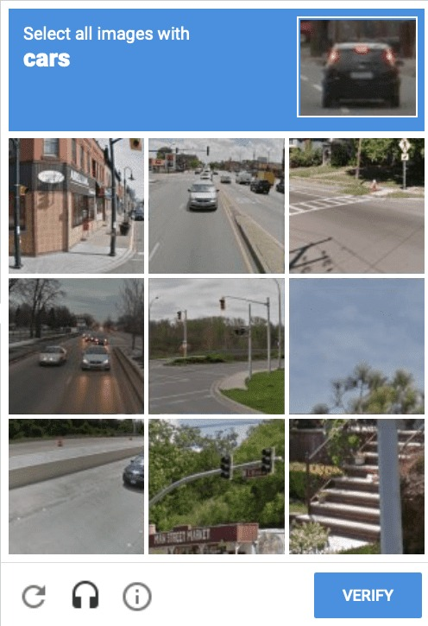
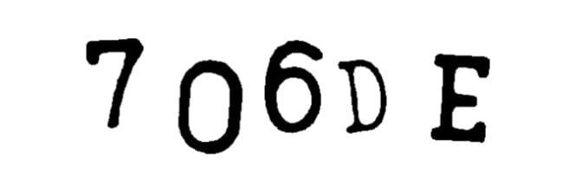
Problem statement
Cracking simple alphanumeric and image CAPTCHA CODES using image processing and Convolutional Neural Networks.

Slide 4
TEAM ROLES AND RESPONSIBILITIES
Ankita Anand and Ankita Muni
Working of Image Processing and Neural Networks and training CNN Model to give predictions.
Anika P and Aditi Prakash
Creating a easy-to-use and user-friendly Graphical User Interface(GUI) to generate the required output and integrating the CNN model with the GUI

Slide 5
LIST OF MODULES
BUILT-IN/ IMPORTED MODULES:
Tkinter- Graphical User Interface
OS- accessing image file paths
PIL- image display and processing
Keras- for building neural networks
Tensorflow- for building neural networks
Numpy- operations on arrays
Open CV- image display and processing
USER DEFINED MODULES:
CAPTCHA.py
ReCAPTCHA.py
gui.py
Open_new_window
Open_new_window2
submitpath
ReCAPTCHA model training: https://colab.research.google.com/drive/14TbNGsdXFORKJPjS7x6qGp67ga4wK3DZ#scrollTo=L10J-pGBTB8W
CAPTCHA model training:
https://colab.research.google.com/drive/1TKskkH0APSeXiOH9B9V4kCgMxzhRFySD#scrollTo=WtNjcuZiIezj

Slide 6
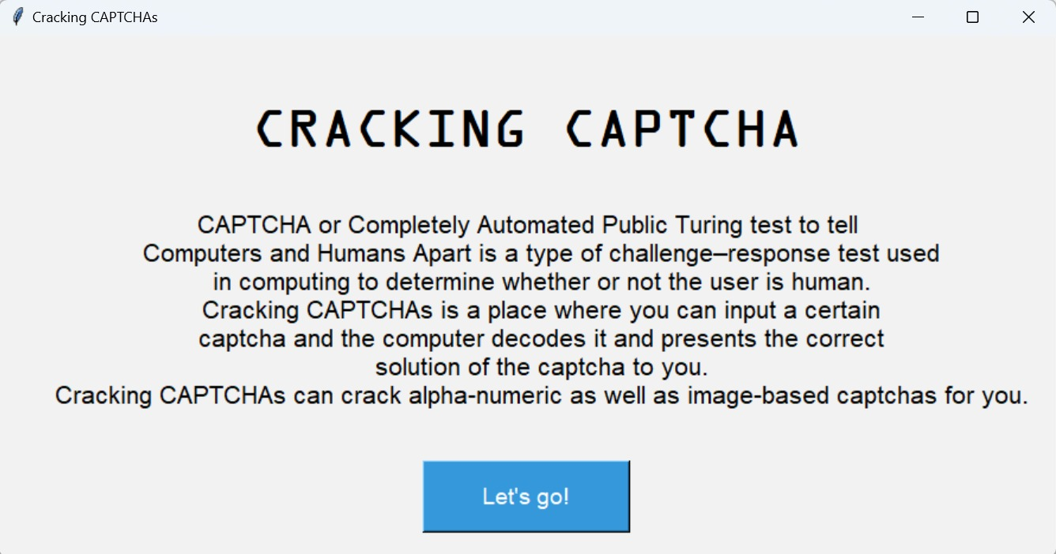
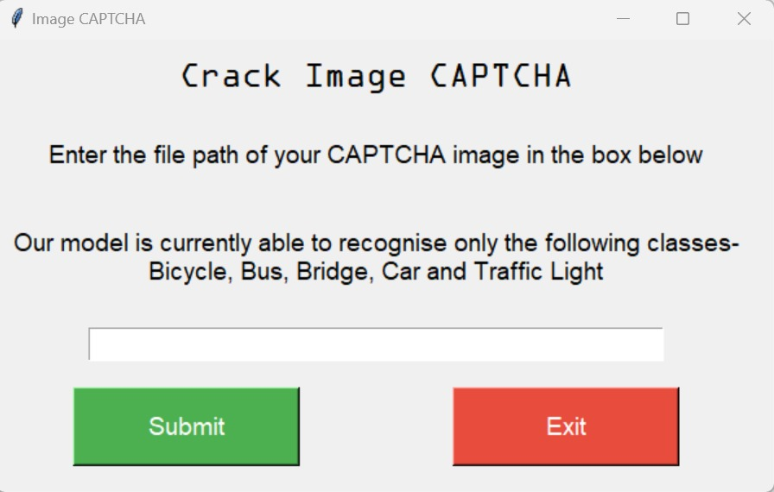
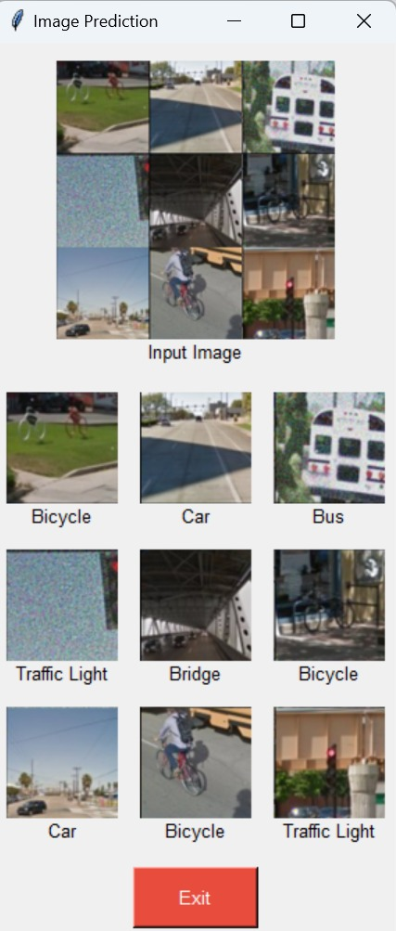
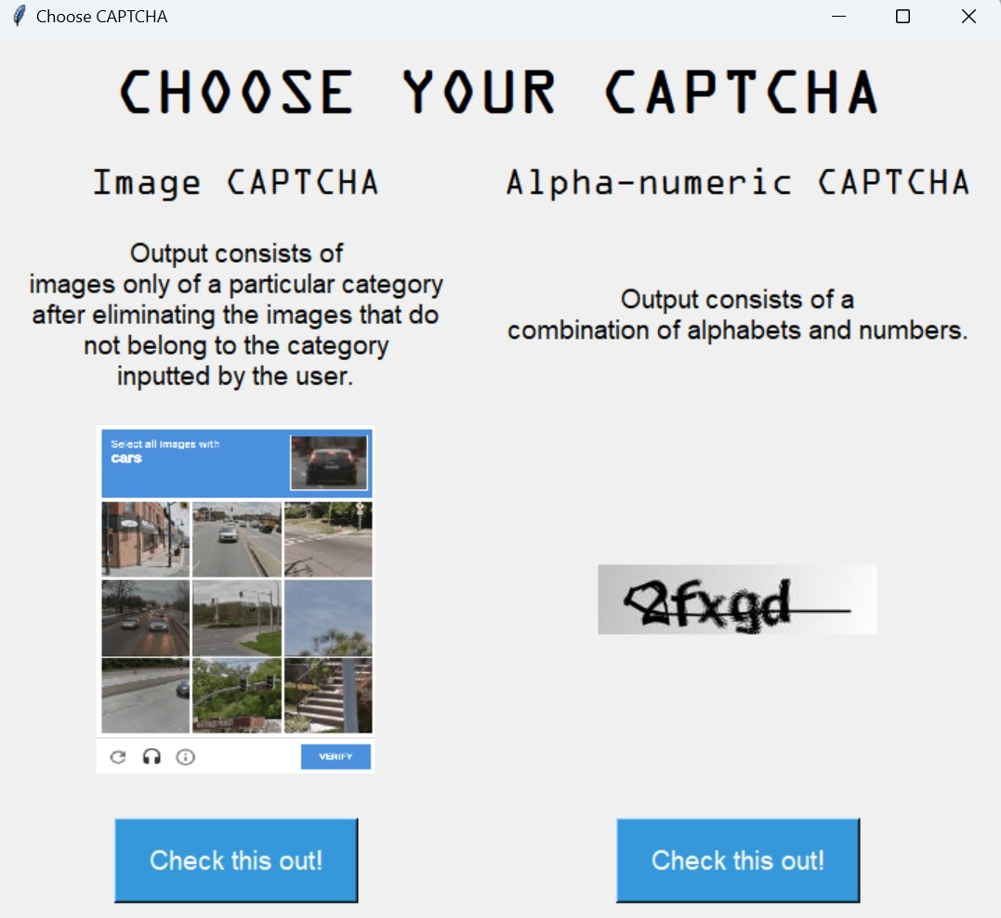
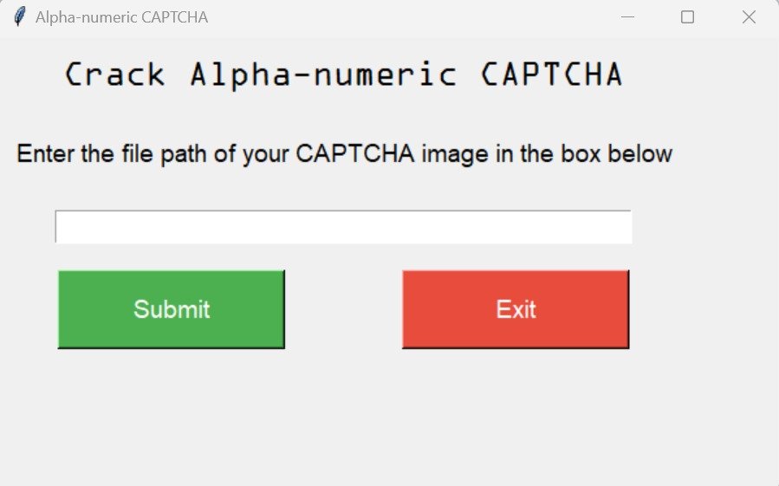
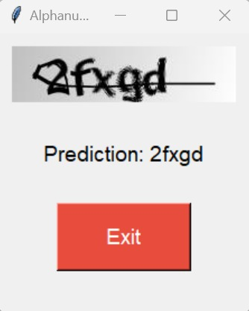
RESULTS AND DISCUSSION

Slide 7
Learning from this project
We learnt how to divide responsibilities within the team and work together as a team to fulfill the project and bring out the best possible results.
We learnt how reinforcement learning works and how it is implemented in Artificial Intelligence(AI) and Machine Learning(ML).
We understood the applications of Neural Networks in decoding CAPTCHAs.
We understood how to build and integrate user-friendly GUI.
We learnt how to build a project which showcased the ideas we had in our mind.

Slide 8
conclusion
All of us understood the importance of team work in completing a project and also diving the work load among us. We realized that we can also build projects that work as solutions to various real-time problems and a basic knowledge of coding is enough for it. Our project will help those people who are dyslexic or have some kind of disability due to which they cannot decode the CAPTCHA on their own. Our project has further scope of improvement in other areas as well.

Slide 9
Future work
We learnt how to plan and go about building a project and we can use this knowledge to further build many other complex projects in the mere future.
Currently we are able to decode alphanumeric and image- based CAPTCHA. The project can be further enhanced to be able to decode other various kind of CAPTCHAs.
Alphanumeric- limited to 5 character CAPTCHAs
Image reCAPTCHA – can currently classify only into 5 classes- bus, car, traffic light, bridge and bicycle.
The GUI also can be further enhanced to give the user an even more friendly experience.

Slide 10
References
https://www.geeksforgeeks.org/how-to-break-a-CAPTCHA-system-with-machine-learning/
https://youtu.be/aircAruvnKk?si=vv6rbGbpespRFpJn
Datasets:
ReCAPTCHA:
https://www.kaggle.com/datasets/mikhailma/test-dataset
CAPTCHA:
https://www.kaggle.com/datasets/alizahidraja/CAPTCHA-data

